Slide 1
LCCC COSC – Tools
Laramie County community college
Recursion

Slide 2
Recursive Algorithms
A recursive algorithm is an algorithm that breaks the problem into smaller subproblems and applies the same algorithm to solve the smaller subproblems.
A function that calls itself is a recursive function.
The base case of the algorithm is the part of the algorithm that actually does something and can finish on it its own (at some point)

Slide 3
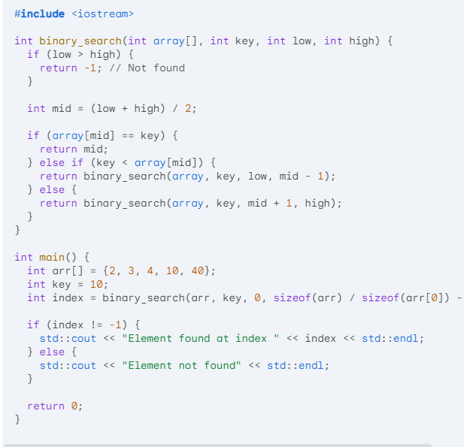
Example – Binary Search Algorithm
Is very efficient on sorted data – O(logN) vs 0(N)
function binary_search(array, key, low, high): This defines the function with four arguments:
  array: The sorted array to search in.
  key: The value to search for.
  low: The starting index of the search.
  high: The ending index of the search.
if low > high then: This checks if the search range is empty (low index is greater than high). If so, return "not found".
mid = (low + high) / 2: This calculates the middle index of the search range.
if array[mid] == key then: This checks if the key is found at the middle index. If so, return the index.
else if key < array[mid] then: If the key is smaller than the middle element, recursively call the function with the left half of the search range (low to mid-1).
else: Otherwise (key is larger than the middle element), recursively call the function with the right half of the search range (mid+1 to high).
Our ZyBook has a very nice page on using output to help debug with indention

Slide 4

Examples
Math functions – Factorials, Fractals, Greatest common divisor (GCD), RaiseToPower
Fibonacci sequence – kind of the famous recursive example
Recursive exploration of all possibilities – works very nicely with trees (we might study these too, if we have time)
Permutations, Combinations
All possible combinations and traveling salesman are very useful cases to know about.

Slide 5
Creating a recursive function
Creating a recursive function can be accomplished in two steps.
  Write the base case -- Every recursive function must have a case that returns a value without performing a recursive call. That case is called the base case. A programmer may write that part of the function first, and then test. There may be multiple base cases.
  Write the recursive case -- The programmer then adds the recursive case to the function.

Slide 6
Beware (a bit)
Stack overflow – Not the programming help site (that’s great) – a situation in which recursion keeps grabbing memory
Specifically, it means a stack frame (the memory allocated to support function calls) extends beyond the memory region allocated for stack. Stack overflow usually causes the program to crash and report an error like: segmentation fault, access violation, or bad access.
Each function call gets its own frame. Recursion can get away from you!
A programmer can estimate recursion depth and stack size to determine whether stack overflow might occur. Sometimes a non-recursive algorithm must be developed to avoid stack overflow.

Slide 7
https://www.programiz.com/cpp-programming/recursion

